Slide 1
Modern .NET development with SQL Server
@ErikEJ

Slide 2
Challenges?
Database schema not in source control
Complex scripts to update schema
Versioning of database vs app a nightmare
Runtime errors in database due to uncaught syntax errors
No standard approach to naming or other database design ”business rules”
No cross platform build and deployment support
No proper NuGet integration

Slide 3
Process
Create / import .sql scripts
Build & Analyze
.dacpac
Deploy
Create SQL project

Slide 4
Tooling
Create / import .sql scripts
Build & Analyze
.dacpac
Deploy
Create SQL project
Visual Studio
VS Code
sqlpackage extract
dotnet new
Azure DevOps pipelines
GitHub actions
sqlpackage publish
MSBuild
dotnet build
dotnet pack Analyzer rules

Slide 5
Demo!

Slide 6
sqlpackage
DacFx
SqlScriptDom
SqlClient

Slide 7
Classic .sqlproj vs MSBuild.SDK.SqlProj
 | .SQLPROJ (Legacy VS) | MSBuild.SDK.SqlProj
Create, build, publish a .dacpac | ✔ | ✔
Run Code Analysis | ✔ (15 rules) | ✔ (120+ rules)
Run custom rules | ✔ (admin only) | ✔
Run rules on hosted agent | ✔ | ✔
Run custom rules on hosted agent | ❌ | ✔
Build on Linux (dotnet build) | ❌ | ✔
Visual designers | ✔ | ❌
NuGet pack (.dacpac/rules) | ❌ | ✔
SQL CLR | ✔ | ❌ (workaround)

Slide 8
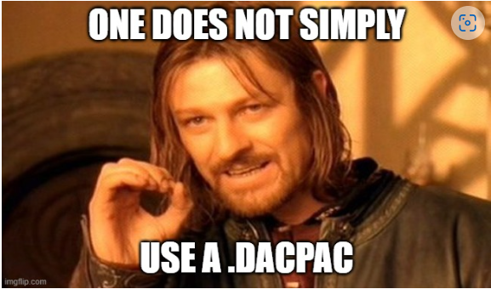
Q & A

Slide 9

CTA
Add you database schema to source control
Enable code analysis locally and in CI
Optional: Create your own rules and contribute them back to the community

Slide 10
Q & A
Handling destructive schema changes?
How do I ”seed data” to my database using a .dacpac?
This is a community project, what is MS doing?
Sharing parts of a database (f.ex. monitoring) ?
Does it work on Azure SQL Databases?
How would this work with EF Core?
How about .NET Aspire?
What if my db has dependencies on other database?
I use Postgres / Oracle /MySQL – can I use this?

Slide 11
What is a dacpac and why should I care?

Slide 12
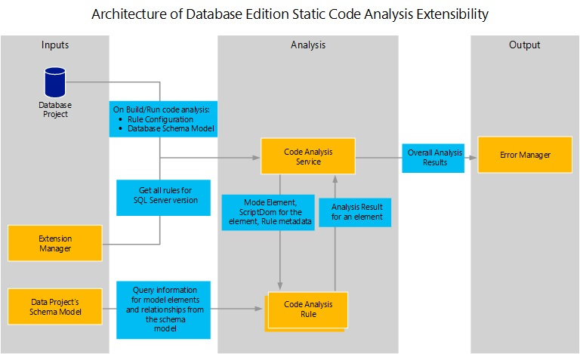

Slide 13
Why?
Data Tier Application Package
Get your database under source control
Ensure your .sql scripts ”build” – code validation
Ensure your .sql scripts follow business rules – code analysis
Deploy changes to the database schema with changes to your app
No more migration scripts – simply describe your desired state
Cross platform build and deployment support

Slide 14

Process
Create .sql scripts
Build
.dacpac
Deploy
Create .sqlproj

Slide 15

Why .dacpac?
Ensure high quality and consistent SQL schema under source control
Enforce design, performance and security rules
Desired state configuration
Publish magic!

